Slide 1
Evaluate RAG System & Evaluation Metrics

Slide 2
components in a RAG system
Retriever: It identifies the most relevant information from the vector database using the power of similarity search. This stage is the most critical part of any RAG system as it sets the foundation for the quality of the final output. The retriever searches a vector database to find documents relevant to the user query. It involves encoding the query and the documents into vectors and using similarity measures to find the closest matches.
Response generator: Once the relevant documents are retrieved, the user query and the retrieved documents are passed to the LLM model to generate a coherent, relevant, and informative response. The generator (LLM) takes the context provided by the retriever and the original query to generate an accurate response.

Slide 3
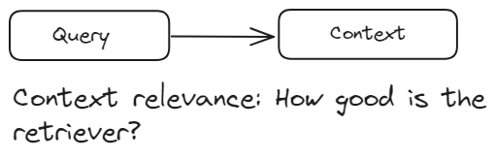
Retrieval Evaluation
Retrieval evaluations are applied to the retriever component of an RAG system, which typically uses a vector database. These evaluations measure how effectively the retriever identifies and ranks relevant documents in response to a user query. The primary goal of retrieval evaluations is to assess context relevance—how well the retrieved documents align with the user's query. It ensures that the context provided to the generation component is pertinent and accurate.

Slide 4
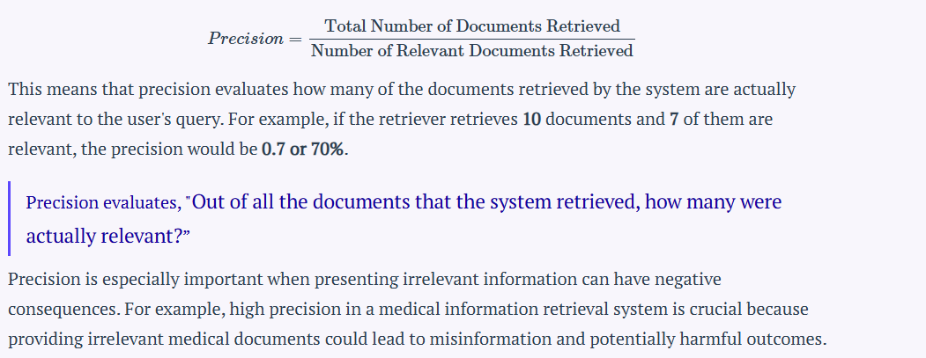
Retrieval Evaluation
Precision measures the accuracy of the retrieved documents. It is the ratio of the number of relevant documents retrieved to the total number of documents retrieved. It’s defined as:

Slide 5
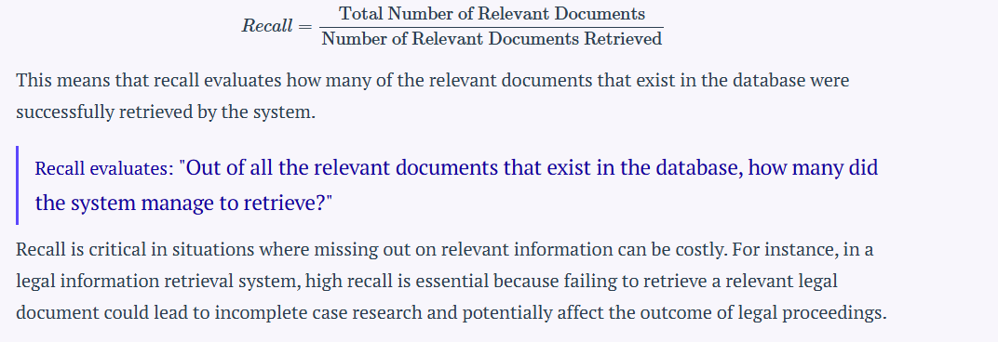
Recall measures the comprehensiveness of the retrieved documents. It is the ratio of the number of relevant documents retrieved to the total number of relevant documents in the database for the given query. It’s defined as:

Slide 6
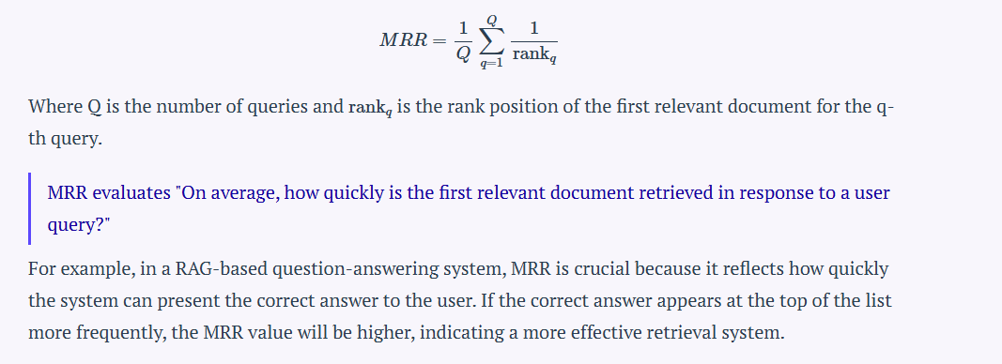
Mean Reciprocal Rank (MRR) is a metric that evaluates the effectiveness of the retrieval system by considering the rank position of the first relevant document. It is particularly useful when only the first relevant document is of primary interest. The reciprocal rank is the inverse of the rank at which the first relevant document is found. MRR is the average of these reciprocal ranks across multiple queries. The formula for MRR is:

Slide 7
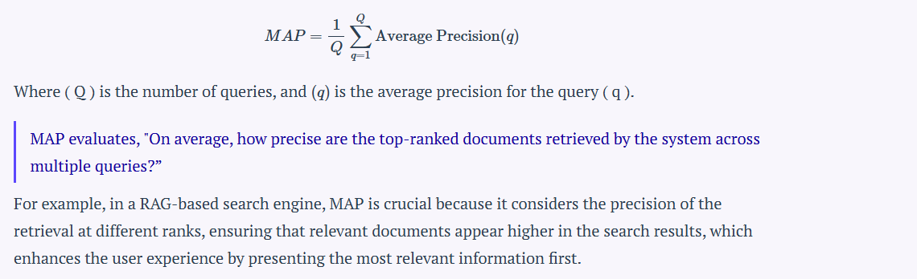
Mean Average Precision (MAP) is a metric that evaluates the precision of retrieval across multiple queries. It takes into account both the precision of the retrieval and the order of the retrieved documents. MAP is defined as the mean of the average precision scores for a set of queries. To calculate the average precision for a single query, the precision is computed at each position in the ranked list of retrieved documents, considering only the top-K retrieved documents, where each precision is weighted by whether the document is relevant or not. The formula for MAP across multiple queries is:

Slide 8
overview of the retrieval evaluations
Precision: Quality of retrieved results.
Recall: Completeness of retrieved results.
MRR: How quickly the first relevant document is retrieved.
MAP: Comprehensive evaluation combining precision and rank of relevant documents

Slide 9
Response Evaluation
Response evaluations are applied to the generation component of a system. These evaluations measure how effectively the system generates responses based on the context provided by the retrieved documents. We divide response evaluations into two types:
Faithfulness (Groundedness)
Answer Relevance

Slide 10
Faithfulness (Groundedness)
Faithfulness evaluates whether the generated response is accurate and grounded in the retrieved documents. It ensures that the response does not contain hallucinations or incorrect information. This metric is crucial because it traces the generated response back to its source, ensuring the information is based on a verifiable ground truth. Faithfulness helps prevent hallucinations, where the system generates plausible-sounding but factually incorrect responses.
To measure faithfulness, the following methods are commonly used:
Human Evaluation: Experts manually assess whether the generated responses are factually accurate and correctly referenced from the retrieved documents. This process involves checking each response against the source documents to ensure all claims are substantiated.
Automated Fact-Checking Tools: These tools compare the generated response against a database of verified facts to identify inaccuracies. They provide an automated way to check the validity of the information without human intervention.
Consistency Checks: These evaluate if the model consistently provides the same factual information across different queries. This ensures that the model is reliable and does not produce contradictory information.

Slide 11
Answer Relevance
Answer relevance measures how well the generated response addresses the user's query and provides useful information.

Slide 12
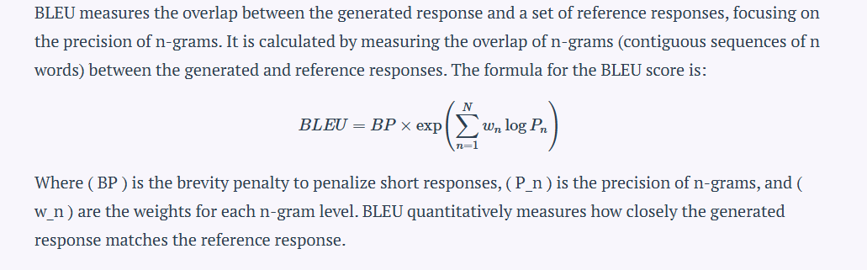
BLEU (Bilingual Evaluation Understudy)
https://medium.com/data-science-in-your-pocket/llm-evaluation-metrics-explained-af14f26536d2

Slide 13
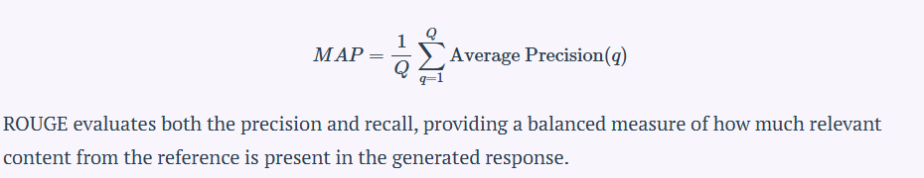
ROUGE (Recall-Oriented Understudy for Gisting Evaluation)
ROUGE measures the overlap of n-grams, word sequences, and word pairs between the generated and reference responses, considering both recall and precision. The most common variant, ROUGE-N, measures the overlap of n-grams between the generated and reference responses. The formula for ROUGE-N is:

Slide 14
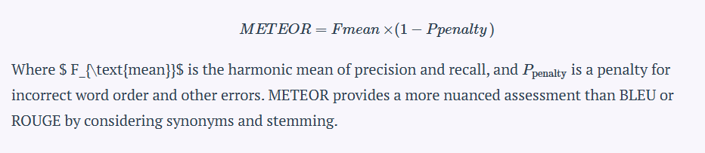
METEOR (Metric for Evaluation of Translation with Explicit ORdering)
METEOR considers synonymy, stemming, and word order to evaluate the similarity between the generated response and the reference responses. The formula for the METEOR score is:

Slide 15
Embedding-Based Evaluation
This method uses vector representations of words (embeddings) to measure the semantic similarity between the generated response and the reference responses. Techniques such as cosine similarity are used to compare the embeddings, providing an evaluation based on the meaning of the words rather than their exact matches.

Slide 16
BERTScore
BERTScore uses a pre-trained BERT model to evaluate the quality of generated text compared to a reference text. It measures the semantic similarity between the two texts using BERT embeddings.

Slide 17
General Purpose Metric
Perplexity
Perplexity but it is a key metric used to evaluate how well a language model predicts a sequence of words in the answer. Also, it doesn’t require Ground Truth!

Slide 18
